Slide 1

CATCH AND PROLONG: RECURRENT NEURAL NETWORK FOR SEEKING TRACK-CANDIDATES
The XXII International Scientific Conference of Young Scientists and Specialists (AYSS-2018)
P.Goncharov, A.Tsytrinov
Gomel State Technical University, Gomel, Belarus
D. Baranov, G.Ososkov
LIT JINR, Dubna, Russia

Slide 2
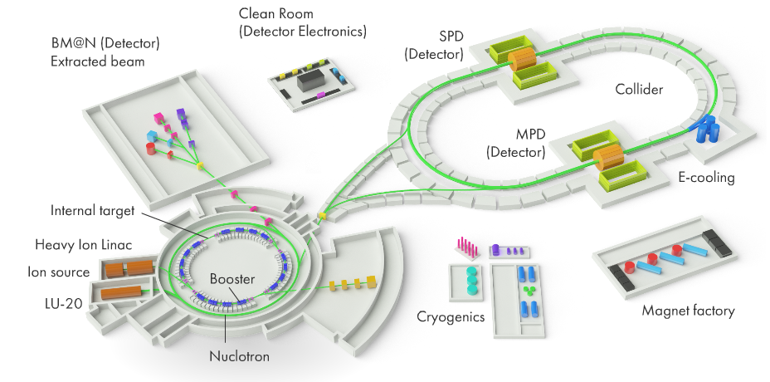
NICA-MPD-SPD-BM@N
General view of the NICA complex with the collider
experiment MPD and experiments MPD, SPD, BM@N

Slide 3
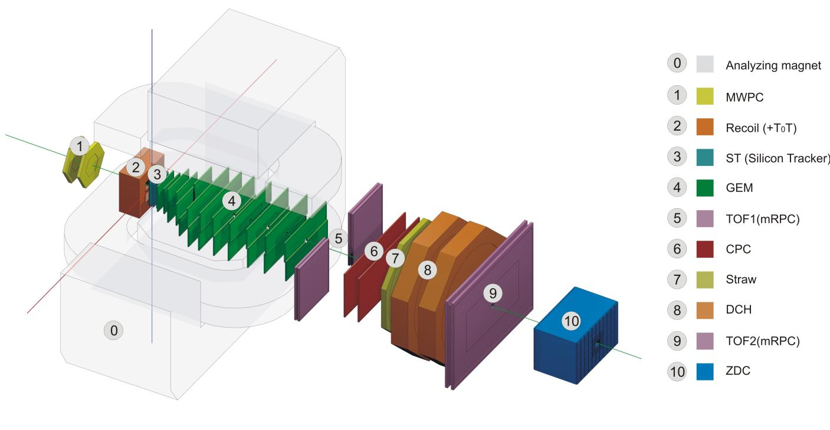
Baryonic Matter at Nuclotron (BM@N)
Our problem is to reconstruct tracks registered by the GEM vertex detector with 6 GEM-stations (winter 2016 configuration) inside the magnet.
All data for further study was simulated in the MPDRoot framework with GEANT Box generator

Slide 4
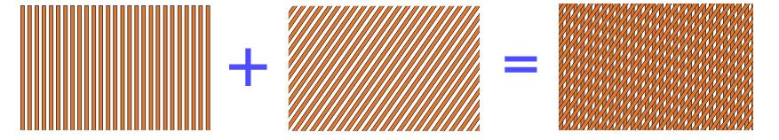
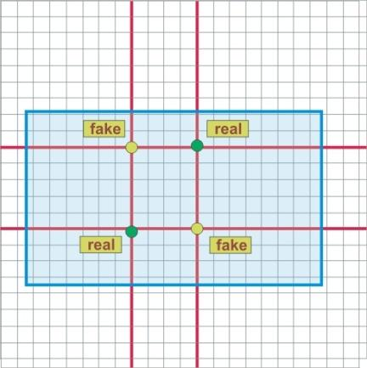
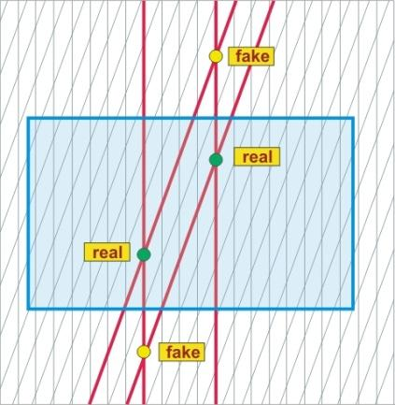
Problems of microstrip gaseous chambers
The general schema of construction of any GEM-station
Layer of vertical strips
Layer of inclined strips
Complete readout plane
The main shortcoming is the appearance of fake hits caused by extra spurious strip crossings. For n real hits one gains ${\text{n}}^{2}$- n fakes
We can significantly reduce the number of observed fakes by adding a stereo-angle between layers of strips (15˚)
It worse to note, that the too high reducing of the angle, increases the Y-coord error
Although small angle between layers removes a lot of fakes, pretty much of them are still left

Slide 5
Event reconstruction is the key problem of HENP data analysis
Event reconstruction is one of the most important problems in the modern high energy and nuclear physics (HENP). It consists on determination of parameters of vertices and particle tracks for each event.
Traditionally tracking algorithms based on the combinatorial Kalman Filter have been used with great success in HENP experiments for years.
However, the initialization procedure needed to start Kalman Filtering requires a tremendous search of hits aimed to obtain so-called “seeds”, i.e. initial approximations of track parameters of charged particles.
Besides these state-of-the-art techniques are inherently sequential and scale poorly with the expected increases in detector occupancy in new conditions as for planned NICA experiments.
Machine learning algorithms bring a lot of potential to this problem due to their capability to model complex non-linear data dependencies, to learn effective representations of high-dimensional data through training, and to parallelize on high-throughput architectures such as GPUs.

Slide 6
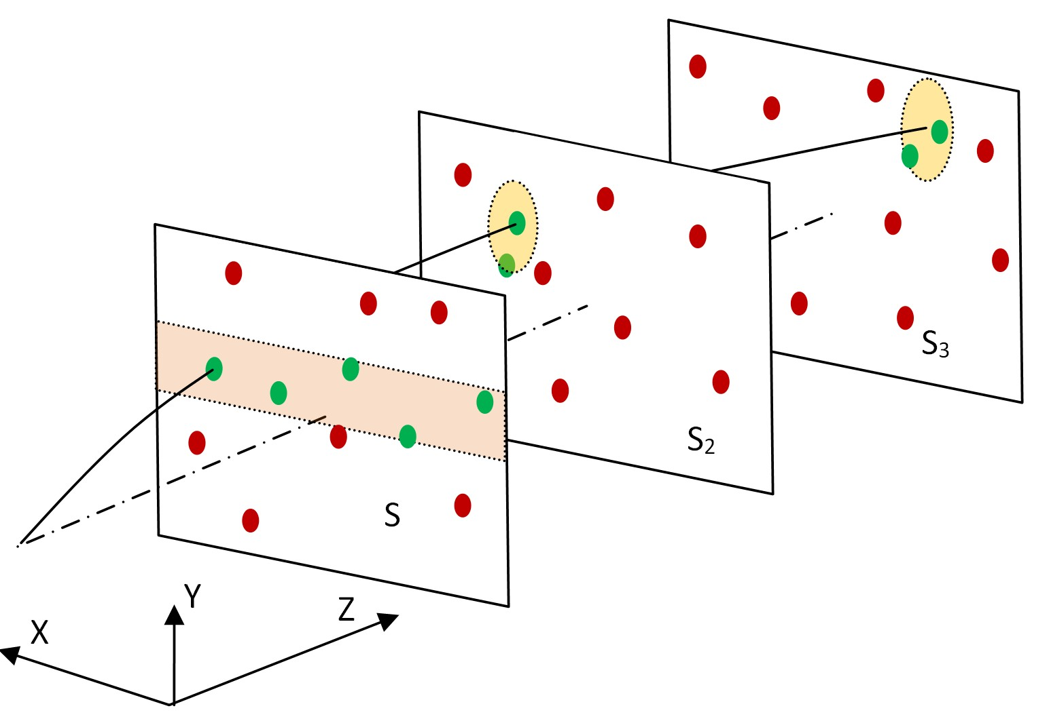
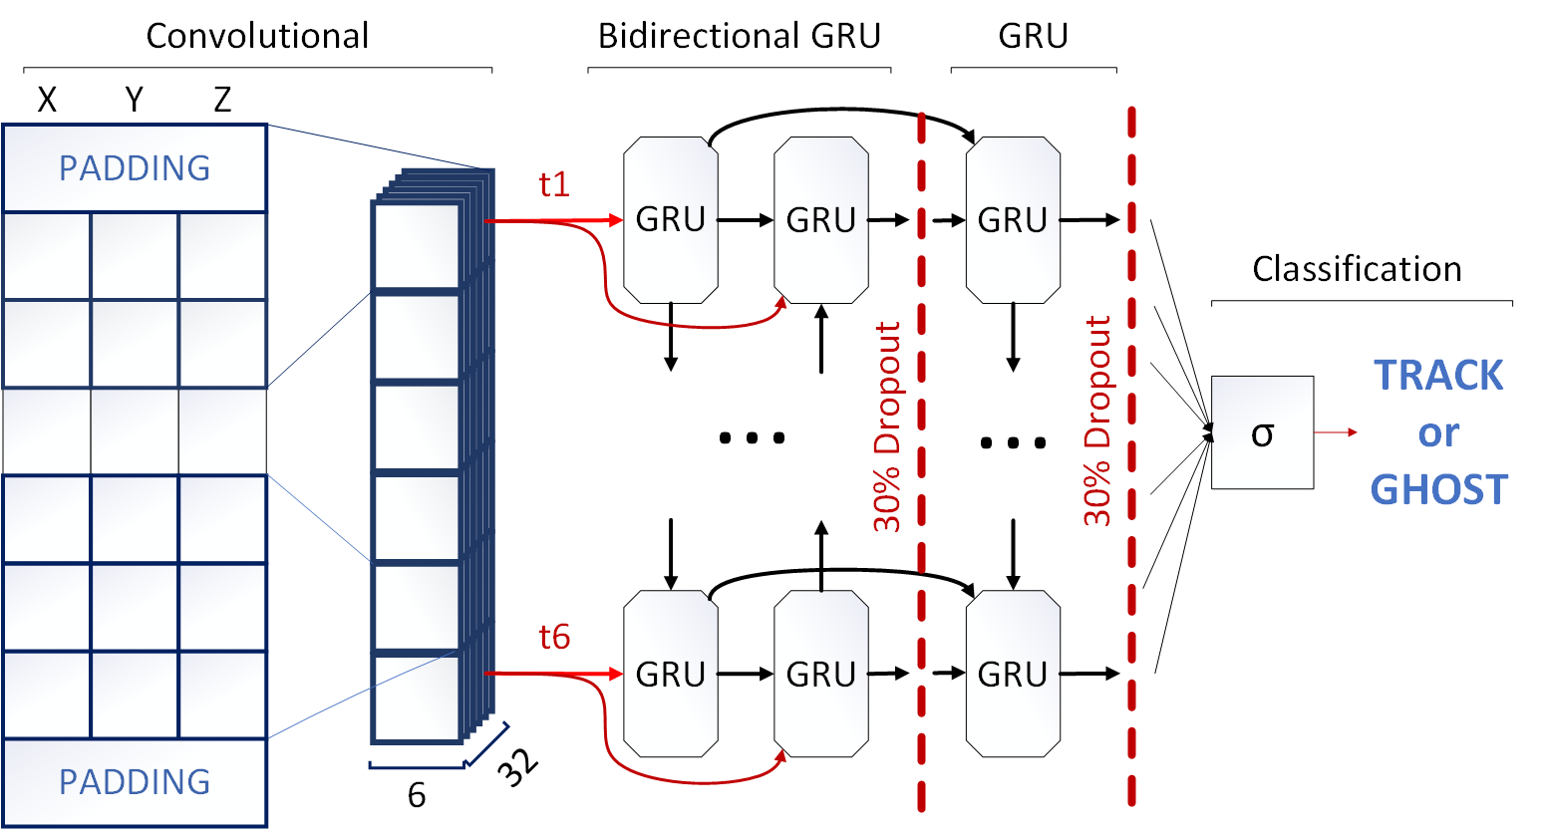
Two-step tracking
Our last solution - two step tracking procedure:
Preprocesing by directed K-d tree search to find all possible track-candidates as clusters joining all hits from adjacent GEM stations lying on a smooth curve.
Deep recurrent network trained on the big simulated dataset with 82 677 real tracks and 695 887 ghosts classifies track-candidates in two groups: true tracks and ghosts.
1) Directed K-d Tree Search
2) Deep Recurrent Neural Network Classifier
Bunch of
track-candidates

Slide 7
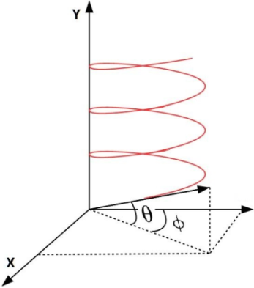
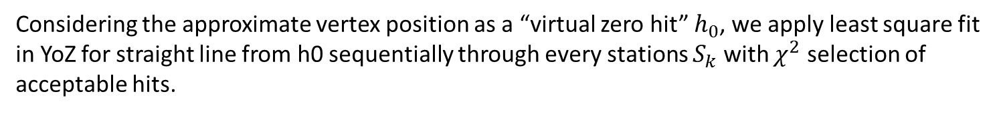
How does it work?! Preliminary search
Magnetic field
direction
BM@n magnetic field is not homogenious, but fortunately, due to its vertical direction we have track YoZ projection close to straight line and XoZ projection close to a circle.
Z
Hence we choose 2D combined search.
Сonsidering the approximate vertex position as a “virtual zero hit” $h_{0}$, we apply least square fit in YoZ for straight line from h0 sequentially through every stations $S_{k}$ with $χ^{2}$ selection of acceptable hits.
In XoZ the selection between corresponding hits to join them into track-candidats is done with “sinus criterion” of closeness of angle sines between three adjacent segments.
Due to applying KD-tree algorithm ( https://arxiv.org/abs/cs/9901013) we speed up our algorithm significantly reducing the search area on the every next station to a rather small elliptic square.

Slide 8
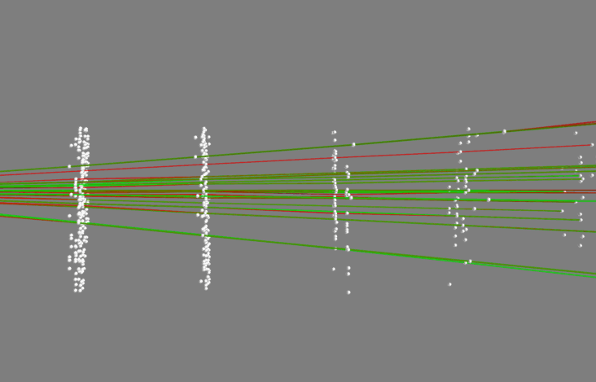
Example of preprocessing results
Real track
Input data for the first step algorithm were simulated by GEANT in MPDRoot framework for the real BM@N configuration.
Ghost track

Slide 9
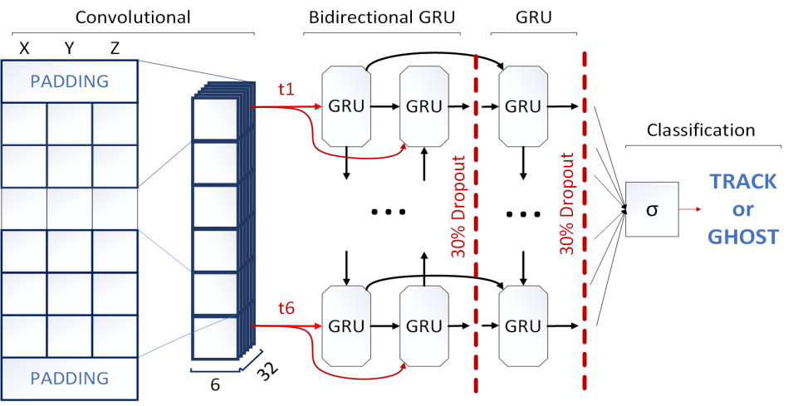
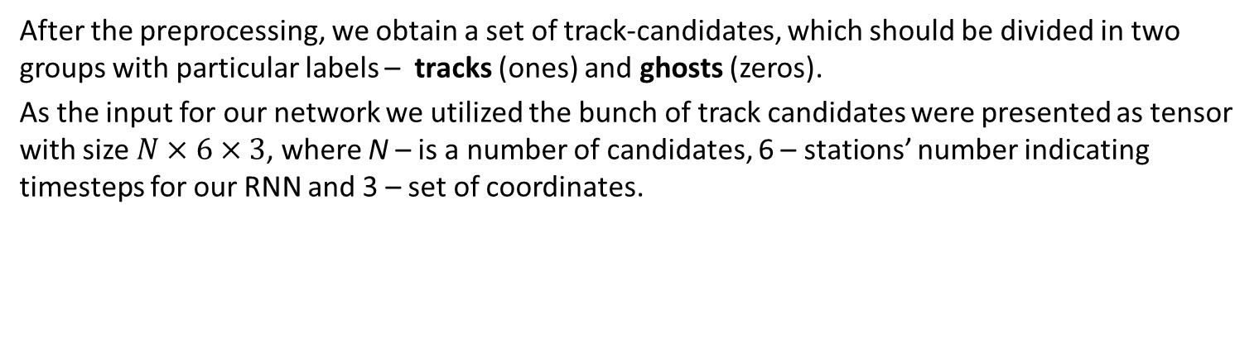
2d step. Track-candidate classification
After the preprocessing, we obtain a set of track-candidates, which should be divided in two groups with particular labels – tracks (ones) and ghosts (zeros).
As the input for our network we utilized the bunch of track candidates were presented as tensor with size $N×6×3$, where N – is a number of candidates, 6 – stations’ number indicating timesteps for our RNN and 3 – set of coordinates.
https://r2rt.com/written-memories-understanding-deriving-and-extending-the-lstm.html

Slide 10
Results of two-step approach
After series of experiments we found the best architecture and parameters for our deep neural classifier of track-candidates.
We trained our network on two datasets:
  small dataset with 80K real tracks and 80K ghost seeds
  big dataset with 82 677 real tracks and 695 887 ghosts
Testing efficiency is the same for both attempts, trained on small and big dataset, and equals to 97.5%.
Trained RNN can currently process 10 666 track-candidates in one second on the single Nvidia Tesla M60 from HybriLIT cloud service and 34 602 track-candidate/sec using Tesla V100 on GOVORUN.
But, it should be mentioned, that the first phase of the event reconstruction – K-d tree preprocessing – takes a lot of time (>1 minute for 100+ tracks event) on the usual laptop, because it should be rebuilt from scratch every time!

Slide 11
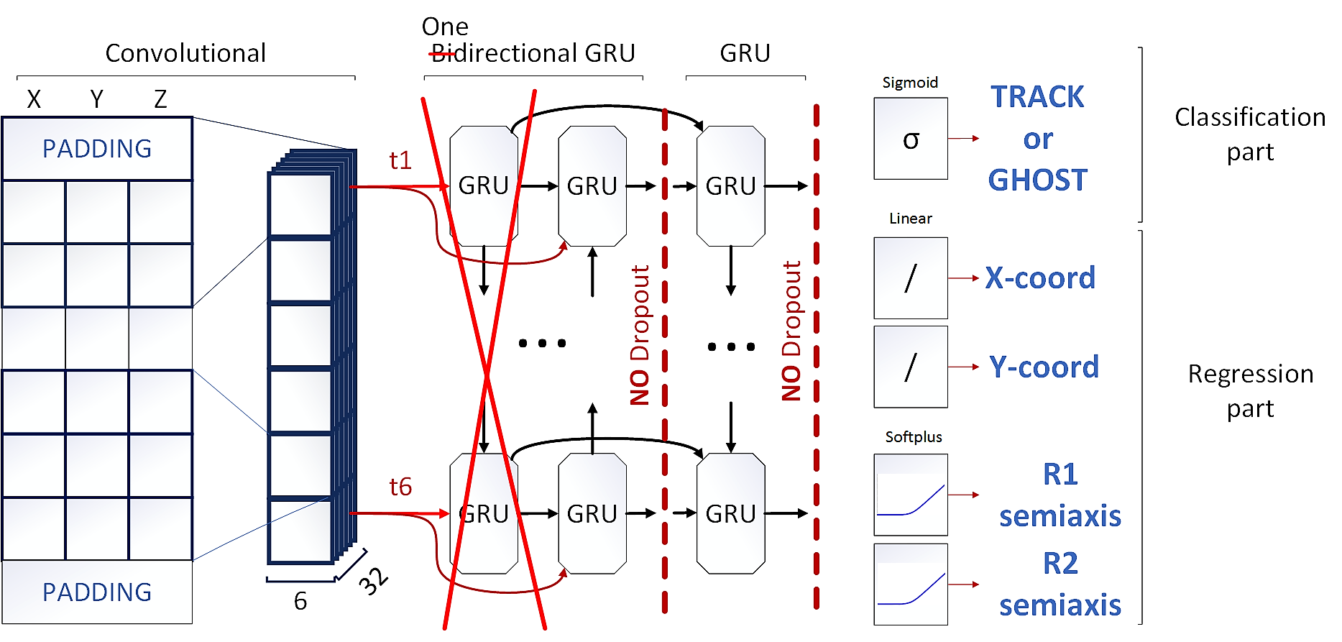
One end-to-end system
Our problem is how to combine
prediction of the continuation of track-candidate and simultaneously
classify whether it belongs to true track or not.

Slide 12
What did we make?
We took our deep RNN classifier from two stage approach and:
Replaced the bidirectional GRU layer with regular GRU
Reduced the number of neurons by half in every recurrent layer
Added special masking layer, that helps to skip empty timesteps
Added the regression part consists of four neurons, two of which predict the point of the center of ellipse on the next coordinate plane, where to search for track-candidate continuation and another two – defines the semiaxis of that ellipse
Set dropout level to zero
Introduced a special loss function to train the whole system

Slide 13


Custom loss function
Point in ellipse loss
Minimizes the ellipse size
Classification error
$$L=\max\left({λ_{1}, 1−p}^{′}\right)FL\left(p, p^{′}\right)+p′\left(λ_{2}\sqrt{{\left(\frac{x−x^{′}}{R1}\right)}^{2}+{\left(\frac{y−y^{′}}{R2}\right)}^{2}}+λ_{3}R1R2\right)$$
p’ – the probability of track/ghost was predicted by deep RNN
p – the label that indicates whether or not the set of points belongs to true track
x’, y’ – the center of ellipse, predicted by network
x, y – the next point of the true track segment
R1, R2 - semiaxis of the ellipse
$\max\left({λ_{1}, 1−p}^{′}\right)$, $p′$ - coefficients that weights classification and regression parts, e.g. we don’t need to search for the continuation of track candidate if it is a ghost
$λ_{1−3}$ – weights for each part of equation
$$FL\left(p, p^{′}\right)= \left\{\begin{aligned}−α{ \left(1−p^{′}\right)}^{γ} log\left(p^{′}\right) if p=1 \\ −\left(1−α\right){ p}^{′γ} log\left(1−p^{′}\right) otherwise\end{aligned}\right.$$
FL is a balanced focal loss with a weighting factor $α∈\left[0, 1\right]$ – common method for addressing class imbalance. We set $α=0.95$, The focusing parameter $γ$ (we set it to 2)
smoothly adjusts the rate at which easy examples are down-weighted.

Slide 14
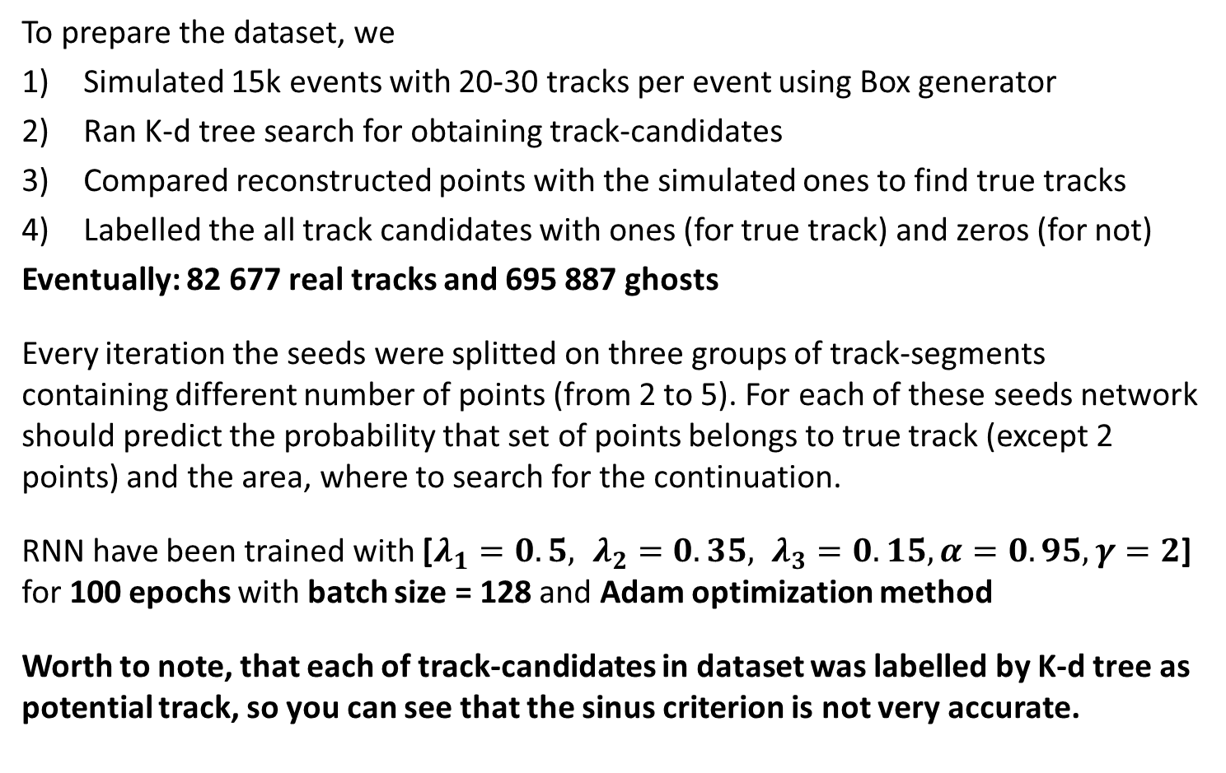
Dataset and Training setup
To prepare the dataset, we
Simulated 15k events with 20-30 tracks per event using Box generator
Ran K-d tree search for obtaining track-candidates
Compared reconstructed points with the simulated ones to find true tracks
Labelled the all track candidates with ones (for true track) and zeros (for not)
Eventually: 82 677 real tracks and 695 887 ghosts
Every iteration the seeds were splitted on three groups of track-segments containing different number of points (from 2 to 5). For each of these seeds network should predict the probability that set of points belongs to true track (except 2 points) and the area, where to search for the continuation.
RNN have been trained with [$λ_{1}=0.5, λ_{2}=0.35, λ_{3}=0.15, α=0.95, γ=2$] for 100 epochs with batch size = 128 and Adam optimization method
Worth to note, that each of track-candidates in dataset was labelled by K-d tree as potential track, so you can see that the sinus criterion is not very accurate.

Slide 15
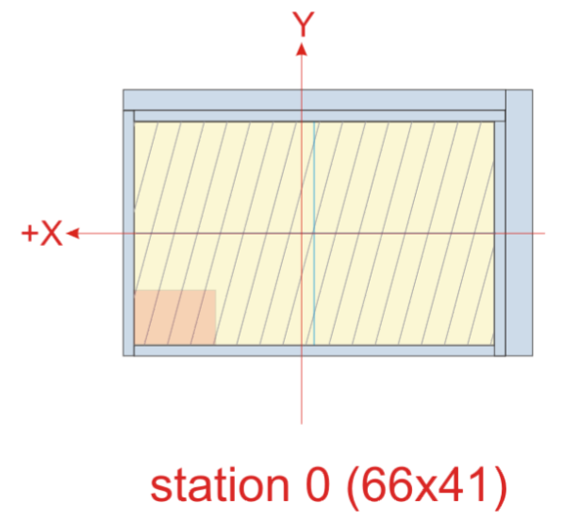
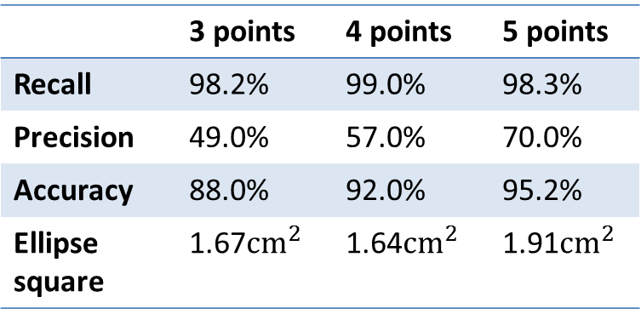
Results
We have tested the trained neural network for the different number of points in track-segments
One can compare the size of the smallest station with the size of average predicted ellipse (red point)
 | 3 points | 4 points | 5 points
Recall | 98.2% | 99.0% | 98.3%
Precision | 49.0% | 57.0% | 70.0%
Accuracy | 88.0% | 92.0% | 95.2%
Ellipse square | 1.67$cm^{2}$ | 1.64$cm^{2}$ | 1.91$cm^{2}$
In the hottest region of station 0 the average number of hits located in the area with the size of predicted ellipse is 1.65 hits (for 100k events).
Inference speed – 3 483 608 track-candidate/sec on 2 x Tesla V100 on GOVORUN supercomputer.

Slide 16
Outlook
We are going to:
increase the classification efficiency;
define a new more accurate method for finding the correspondence between hits and simulated points;
create a complete pipeline for the event reconstruction;

Slide 17

Thanks for your attention!
Notes:
17

