Slide 1

Введение в глубокие нейронные сети
2nd International School on
Heterogeneous Computing Infrastructure- NEC'2017
Montenegro, Budva, Becici, 25-29 September, 2017
Ососков Г. А., Гончаров П.В.,
Лаборатория Информационных Технологий,
Объединенного института ядерных исследований
email: ososkov@jinr.ru

Slide 2
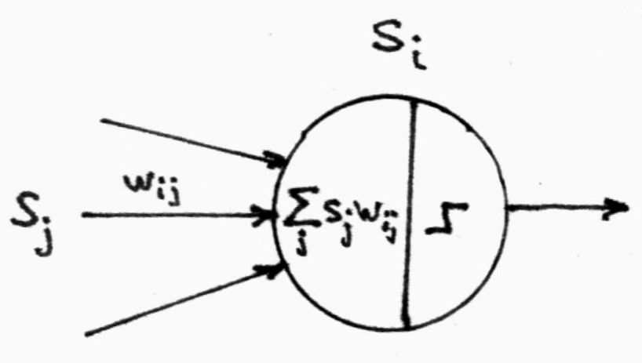
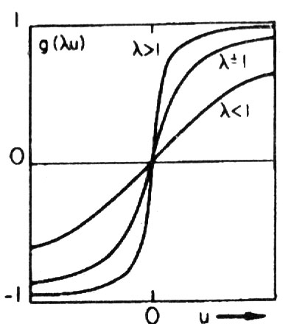

История:
Ramón y Cajal & Camillo Golgi Нобелевская премия 1907 за теорию нейронных систем
MacKallok-Pitts (1943) математическая модель биологического нейрона
D.Hebb (1949) правило обучения нейронов w_{ij}(t+1) - w_{ij}(t) = Δ w_{ij} = ηs_{i}(t)s_{j}(t)
Что получилось
Архитектура искусственных нейронных сетей (ИНС). ИНС состоит из нейронов, –простых логических устройств, характеризуемых:
уровнем активации;
топологией связи друг с другом;
мерой взаимодействия с другими нейронами,
называемой синаптической силой связи или весом.
Веса этих связей различны и должны определяться в зависимости от решаемой задачи.
Вся система состоит из большого числа нейронов. Результат работы ИНС малочувствителен к характеристикам конкретного нейрона.
общий входной сигнал, поступающий
на i-й нейрон от всех остальных нейронов
h_{i} = Σ_{j} w_{ij} s_{j}
Синаптический вес
Функция активации

Slide 3
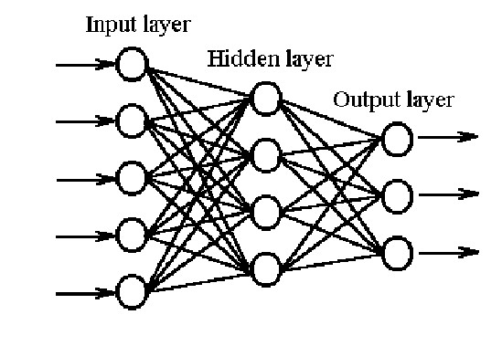
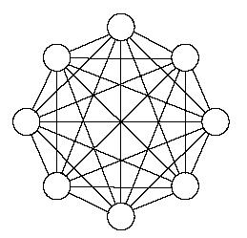
ИНС, применяемые в экспериментальной физике
Прямоточная ИНС или многослойный персептрон (МСП,RBF-сети).
Обучение с учителем.
Цель обучения – определить веса так, чтобы обученная сеть решала задачу распознавания или классификации.
Этапы применения МСП:
Создать обучающую выборку как набор пар (X_{i},Z_{i}), где X_{i} – входное значение, Z_{i} – его целевое значение.
2. Обучить МСП методом обратного распространения ошибки
E=Σ_{m}Σ_{ij} (y_{i} ^{(m)} – z_{i} ^{(m)} )² → min_{{wij}}
3. Протестировать МСП на тестовой выборке
4. Обученная сеть реализуется как программа или нейрочип для очень быстрого применения
h_{i}=g(Σ_{j}w_{ij} s_{j})
2. Полносвязная ИНС
(сеть Хопфилда)
Самообучение

Slide 4
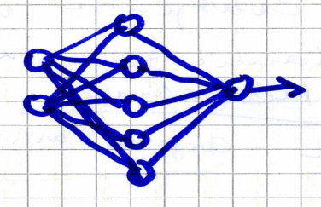
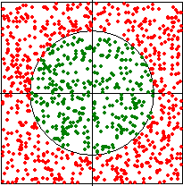
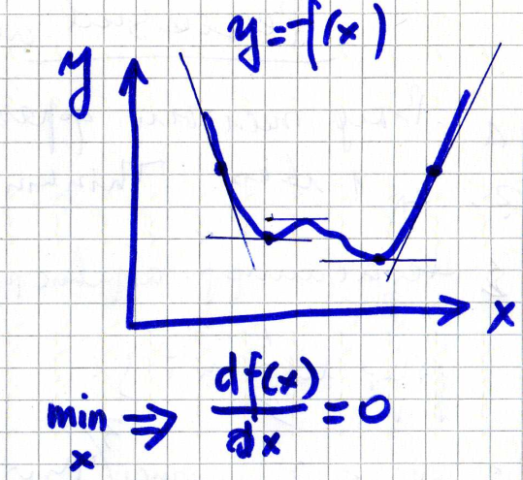
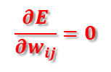
Тайны обучения.
Что внутри черного ящика ИНС?
X
y
Пример. Классификация с помощью МСП
модель обучающей выборки: на вход сети подают по 3 числа (X,Y, Z) : координаты точки X,Y и признак Z (1 - внутри круга или 0 – вне его).
Всего 15 весов
h_{i}=g(Σ_{j}w_{ij} s_{j})
Чтобы обучить МСП методом обратного распространения ошибки, надо минимизировать по всем весам функцию ошибки сети: E=Σ_{m}Σ_{ij} (y_{i} ^{(m)} – z_{i} ^{(m)} )² → min_{{wij}}
Минимизация функции ошибки сети Е
$$\frac{∂E}{∂w_{ij}}=0$$
Т.о. надо решать систему из 15 уравнений
с 15 неизвестными значениями весов w_{ij} w_{jk.}
Обычный метод решения - антиградиентный спуск – хорошо работает для унимодальных функций при удачно выбранном начальном приближении, однако для функции E(w_{ij} ,w_{jk}) характерно овражное строение и наличие многих локальных минимумов.
Поэтому в программах, реализующих ИНС, используется вся «тяжелая артиллерия» вычислительных методов

Slide 5
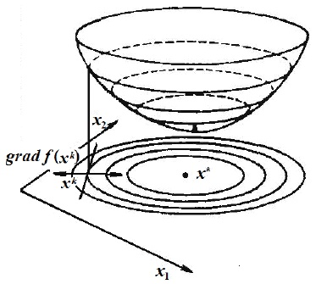
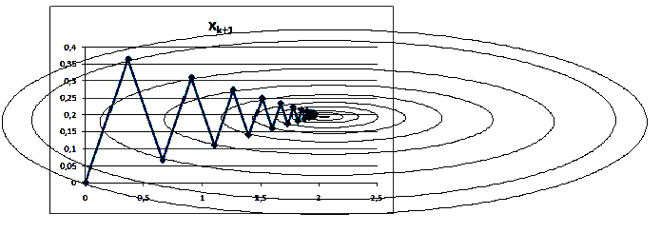
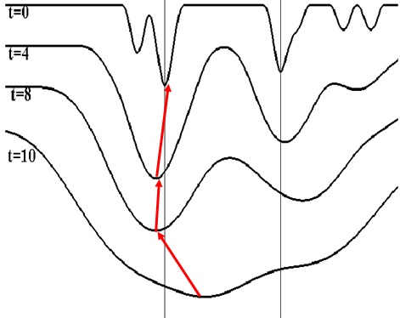

Тайны обучения ИНС – вычислительные приемы
Выход – метод параллельных касательных «партан»
1. Наискорейший спуск для обычной и «овражной» поверхностей
2. Как выбраться из ложного локального
минимума E(w_{ij} ,w_{jk})
Метод симуляции отжига – simulated annealing
λ=1/t E=E(t,W)
3. Метод стохастического градиента (stochastic gradient descent - SGD)

Slide 6
Почему ИНС востребованы в ФВЭ
Artificial neural networks (ANN) with their ability for learning and self-learning are effective ML tools, so physicists accumulated a quite solid experience in various ANN applications in many HENP experiments for the recognition of charged particle tracks, Cherenkov rings, physical hypotheses testing, and image processing .
In particular, - MLP’s are quite popular in physics, moreover namely physicists wrote in 80-ties one of the first NN programing packages – Jetnet. They were also among first neuro-chip users.
Main reasons were:
The possibility to generate training samples of any arbitrary needed length by Monte Carlo on the basis of some new physical model implemented in GEANT simulation program
neuro-chip appearance on the market at that time which make feasible implementing a trained NN, as a hardware for the very fast triggering and other NN application.
the handy MLP realization with the error back-propagation algorithm for its training in TMVA – the Toolkit for Multivariate Data Analysis with ROOT

Slide 7
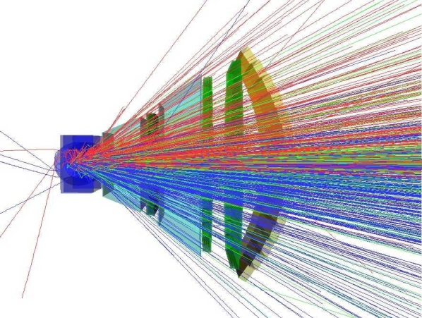
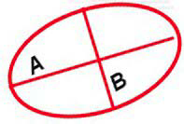
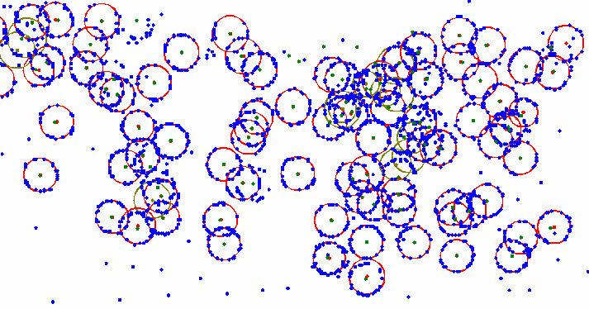
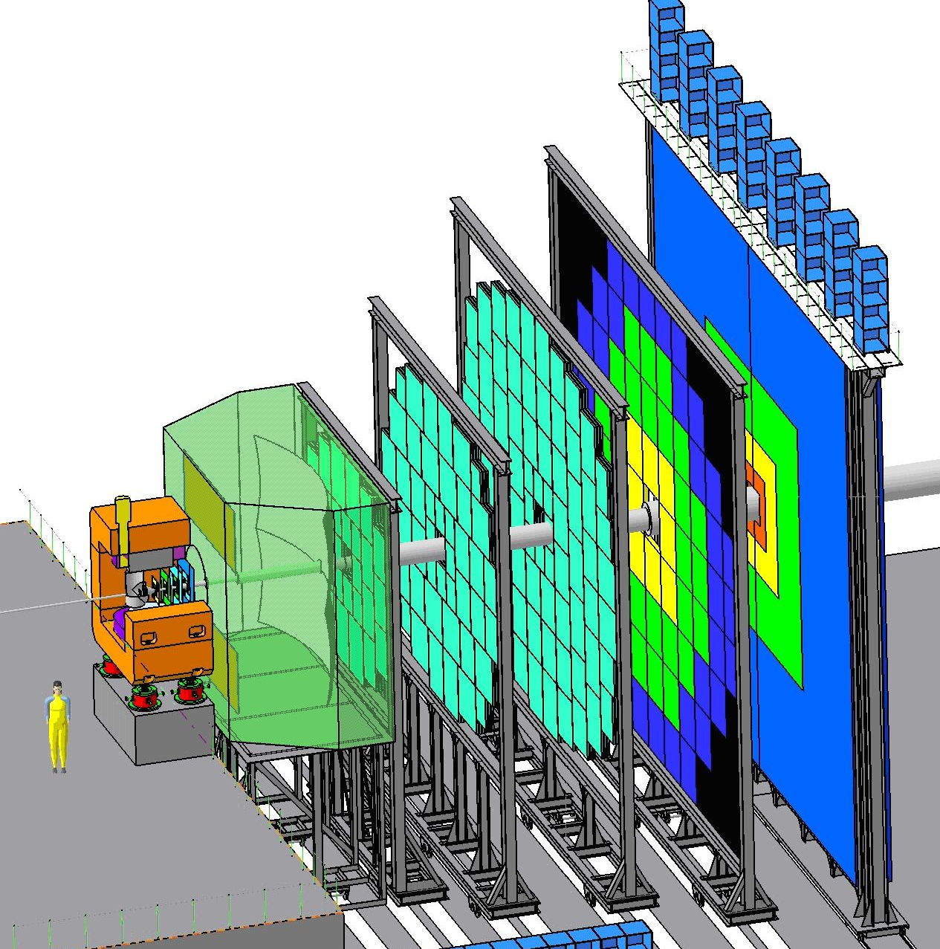
Пример изображений из эксперимента СВМ
Condensed
Barion
Matter
1. СВМ experiment
(Germany, GSI, to be running in 2018)
Data rate: 10⁷ events per sec,
~1000 tracks per event
~100 numbers per track
Total: terabytes/sec !
RICH - Cherenkov
radiation
detector
TRD
RICH
simulated event of the central Au+Au
collision in the vertex detector
schematic view of the СВМ setup
Problems are to recognize all of these tracks and RICH rings and evaluate their parameters despite of their overlapping, noise and optical shape distortions
view of Cherenkov radiation rings
registered by the CBM RICH detector

Slide 8
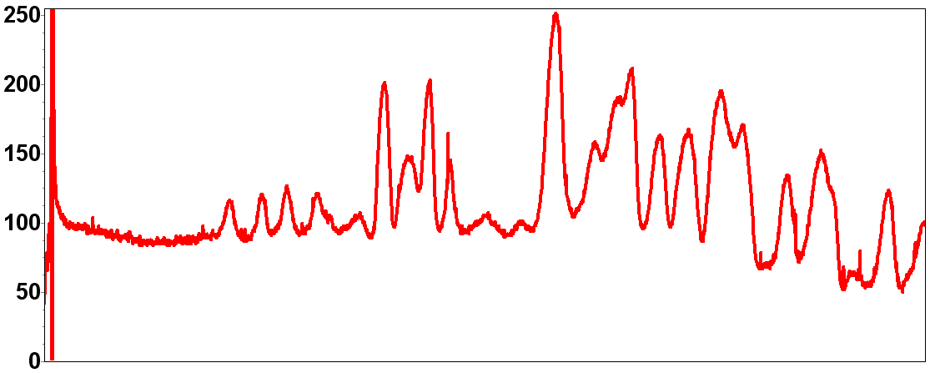
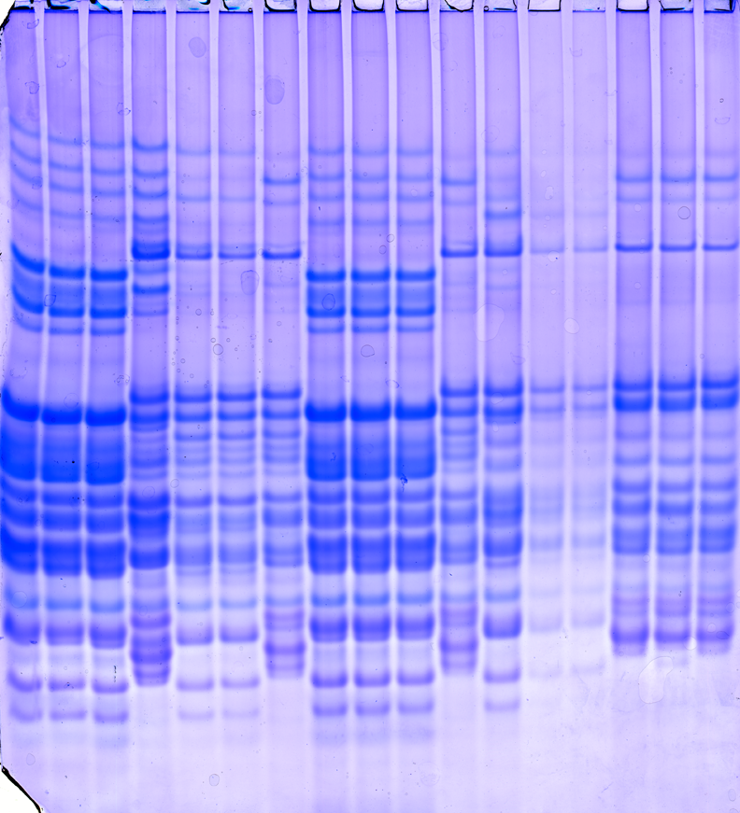
2. Пример изображения из генетики протеинов
The genetics of gliadin (alcohol soluble protein)
have been studied in detail by a special gel
electrophoresis. Each electrophoretogram strip
after its digitalization became a densitogram
spectrum consisting of about 4000 pixels.
It can be considered as a simple genetic formula,
which allows for a qualified expert to classify any spectrum to its corresponding protein.
Electrophoregram example
with 17 wheat cultivar
Such classifying procedure is of great importance in
radiobiology and, especially, in agriculture
Therefore it is to be automatized.

Slide 9
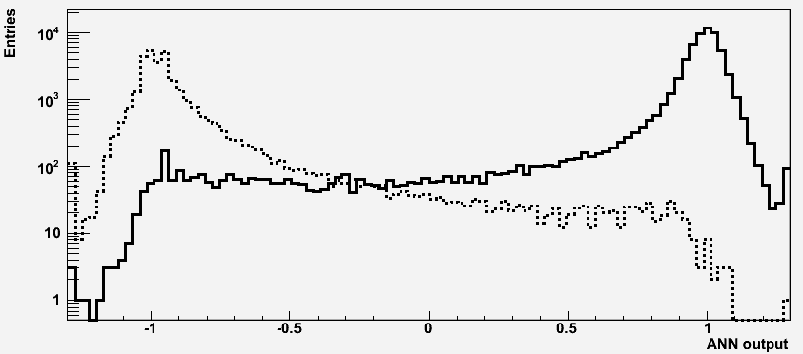
Применения МСП.
1. Классификация колец черенковского излучения
The study has been made to select the most informative ring features needed to
(1) distinguish between good and fake rings and to (2) identify electrons.
Ten of them have been chosen to be input to ANNs, they are:
Number of points in the found ring
Its distance to the nearest track
The biggest angle between two neighbouring points
Number of points in the narrow corridor surrounding ring
Radial ring position on the photodetector plane
χ² of ellipse fitting
Both ellipse half-axes (A and B)
angle φ of the ellipse inclination to abscissa
track azimuth
track momentum
Two samples with 3000 e (+1)and 3000 π (-1) have been simulated to train NN. Electron recognition efficiency was fixed on 90% Probabilities of the 1-st kind error 0.018 and the 2-d kind errors 0.0004
correspondingly were obtained

Slide 10
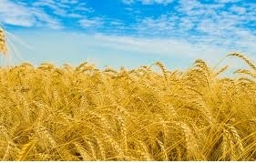
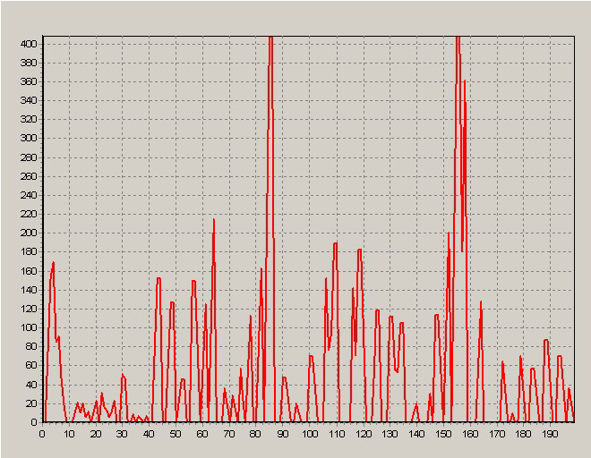
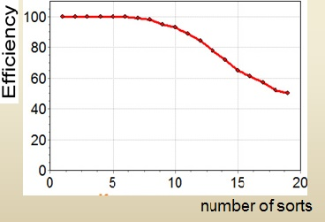

Применения МСП.
2. Genetics of proteins. EF-densitogram classifying by MLP
Important real case, - durum wheat classification
The real size of the training sample is 3225 EF-densitogramms for
50 sorts preliminarily classified by experts for each of wheat sorts
Curse of dimensionality problem
Input: 4000 pixels
Output: 50 sorts to be classified
ANN dimension D=4000*256+256*50>10^{6,}
i.e millions of weights or equations to solve
by the error back propagation method!
A cardinal reduction of input data preserving essential information is needed
Feature extraction approaches already used
Spectrum coarsening from 4000 points into 200 zones
2. Fourier and wavelet analysis
3. Principal component analysis
4. Peak ranking by amplitudes
.
Input reduction in
more than the order
of magnitude, but too
low classification efficiency

Slide 11
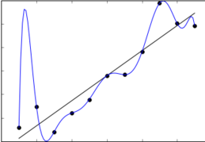
Недостатки метода
обратного распространения ошибок
The learning time does not scale well
– It is very slow in networks with multiple hidden layers.
It can get stuck in poor local optima.
It tends to overfitting
The problem known as the “Curse of dimensionality” hampering MLP applications for image recognition despite of any attempts to reduce input data preserving essential information.
It requires labeled training data (what is the privilege of HENP).
– Almost all data is unlabeled.
So let us see on different type of NN – reccurrent NN
The exhausted analysis of BP shortcomings and effective ways to overcome them one can find in Yann LeCun’s paper “Efficient BackProp” : http://yann.lecun.com/exdb/publis/pdf/lecun-98b.pdf
10 parameters instead of 2

Slide 12

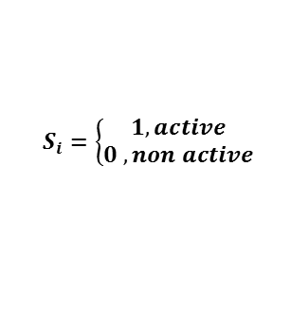
Полносвязные сети Хопфилда
The recurrent NN considered as a dynamic system of binary neurons. All them are connected together with weights w_{ij.}
Hopfield’s theorem: the energy function
E(s) = - ½ Σ_{ij} w_{ij} s_{i} s_{j}
of a recurrent NN with the symmetrical weight matrix
w_{ij} = w_{ji} , w_{ii} = 0 has local minima corresponding to NN stability points.
$$S_{i}=\left\{\begin{aligned}1, active \\ 0 , non active\end{aligned}\right.$$
s_{i}
w_{ij}
s_{i}
However the usual way of E(s) minimizing by updating the equation system, which defines the ANN dynamics: would bring us to one of many local minima.
Since our goal is to find the global minimum of E we have to apply the mean-field-theory (MFT). According to it, all neurons are thermalized by inventing temperature T, as λ=1/T and s_{i} are substituted by their thermal averages v_{i} = < s_{i} >_{T} , which are now continuous in the interval [0,1]. Then ANN MFT dynamics is determined by the updating equation
v_{i} =1/2(1+tanh(-∂E/∂v_{i} 1/T) =1/2(1+tanh(H_{i} /T),
where H_{i} = <Σ_{j} w_{ij} s_{j} >_{T} – is the local mean field of a neuron. Values of v_{i} are now defined the activity level of i^{th} neuron. Neurons with v_{i} > v_{min} determine the most essential ANN-connections

Slide 13
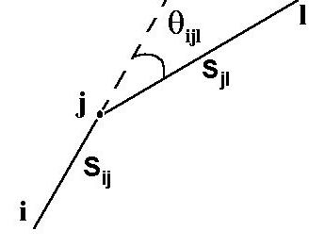

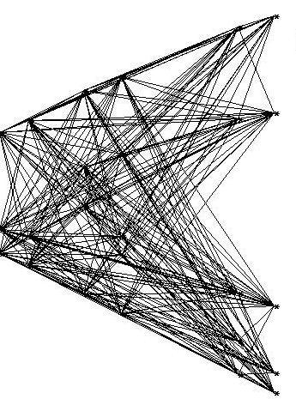
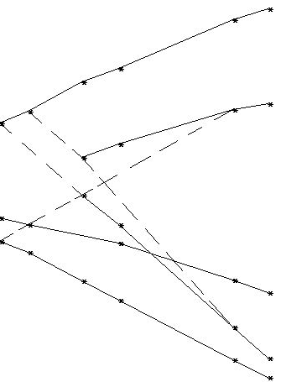
Применение полносвязных ИНС
для распознавания треков
Track recognition by Denby- Peterson (1988) segment model
The idea: support adjacent segments with small angles
between them. It is done by the special energy function:
E = E_{cost} + E_{constraint} , where
An easy example of the EXCHARM experiment with 6 multiwire proportional chambers registering hits from passing particle tracks and noise
Neuron s_{ij} is the segment connecting points i and j
w_{ijkl}
E_{constraint} punishes segment bifurcations and balances between the number of active neurons and the number of experimental points.
Note: adding even a single noise point would generate ~80 extra hampering neurons
After 30 iteration:
26 neurons with v_{ij} >0.5
Zero iteration: 244 neurons.
Thus we have NN with unsupervised learning that trained itself during its evolution

Slide 14
Нейронные сети глубокого обучения
Big Data era.
Technological achievements: HPCs, GPU, clouds.
Biological observations: The mammal brain is organized in a deep architecture, animal visual cortex perceive 3D obejcts.
Problems to be solved are now getting more and more complicated, so the ANN architecture needs to become deeper by adding more hidden layers for better parametrization and more adequate problem modelling. However in most cases deepening, i.e. the fast grow of inter-neutron links, faces the problem known as the “Curse of dimensionality”, which leads to overfitting or to sticking the minimized BP error function in poor local optima.
Hopfield NN could not also be effective enough in cases of noisy and dense events.
Challenge of Deep Learning approach in Neural Networks,
inevitability to use parallelism and virtuality.

Slide 15
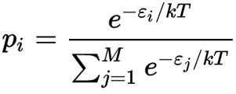
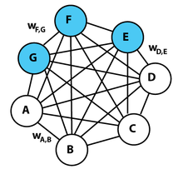
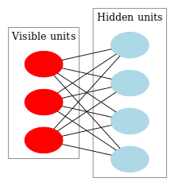
Полносвязные сети как машина Больцмана
Geoffrey Hinton proposed in 2006 a new approach to combine in one neural net both types of NN, - with supervised learning by back-propagation and recurrent NN (RNN) with unsupervised learning.
He considered Hopfield RNN as stochastic NN which state probabilities obey Boltzman distribution ,
as the function of that state’s energy and the system temperature, and named it the Boltzman machine (BM) (hence Boltzman distribution).
Then Hinton divided neurons into groups of visible and hidden ones where visible units V are those which receive information from the 'environment', i.e. our training set is a set of binary vectors over the set V. It allows to find probabilities of hidden neuron states in the way of BM thermal equilibrium.
However, due to serious practical problems with BM training, Hinton proposed a new efficient way in an architecture called the "restricted Boltzmann machine" (RBM) which does not allow intralayer connections between hidden units.
After training one RBM, the activities of its hidden units can be treated as data for training a higher-level RBM. This method of stacking RBMs makes it possible to train many layers of hidden units efficiently and it is one of the most common deep learning strategies. As each new layer is added the overall generative model gets better.
Graphical BM
representation
“Deep” refers to the number of NN layers. Whereas most current learning algorithms, as MLP, correspond to shallow architectures (1, 2 or 3 layers). The mammal brain is organized in a deep architecture.
Graphical representation of a
restricted Boltzmann machine.

Slide 16
Глубокая нейросеть доверия
Thus Hinton introduced Deep Belief Networks (DBN) which is composed of multiple hidden layers, with connections between the layers but not between units within each layer.
The word “belief” here does not mean “faith”, but “confidence” what means we deal with stochastic NN and probability
These layers are restricted Boltzmann machine (RBM) that can learn themselves a probability distribution over its set of inputs. The evolution of RBM layers is realized by Markov chain Monte Carlo (MCMC) method, although its convergence needed to obtain mean values of wanted parameters is always too long to be practical.
Hinton showed, if the learning approximately minimizes a different function called “contrastive divergence" (CD), then Markov chain can run only for just one step, but this trick works surprisingly well.
During the last decade DBNs have been applied with success not only in classification, but also in regression, dimensionality reduction, modeling motions, information retrieval, object segmentation, natural language processing and many others.

Slide 17
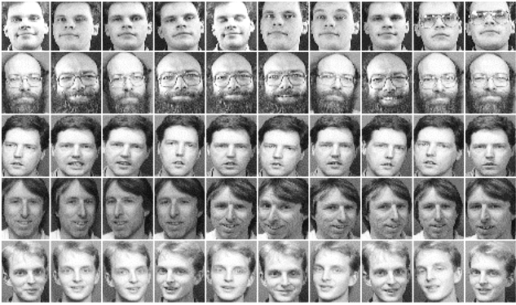
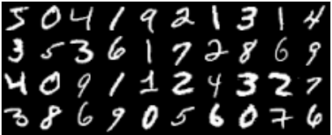
Изучение глубоких нейросетей в ОИЯИ
In the Laboratory of Information Technologies of JINR the program complex for the image recognizing problem was developed. It realizes four neural networks:
Autoassociative NN realizing the nonlinear principal component analysis (NLPCA) intended for the significant compression of input data;
Three NN after a special optimization of their structures and parameters
as image classifiers:
Perceptron with one hidden layer;
Deep Belief Network;
Deep Neural Network (DNN) with initialization of normalized weights.
A study was recently fulfilled to compare the efficiency of these classifiers by testing them on two well-known datasets:
- MNIST handwritten digit database (70,000 handwritten digits images);
- FERET face database (40 people to 10 photos for each).
MNIST handwritten database sample
FERET face database sample

Slide 18
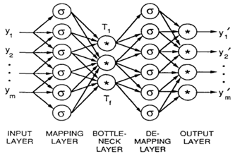
1-й этап: сжатие данных автоэнкодером
An autoencoder (AE) accomplishes unsupervised learning for data compression to a smaller number of the most informative features by realizing the nonlinear principal component analysis (NLPCA). It was proposed by M.Kramer as an autoassociative neural network with three hidden layers including the bottle neck layer in the middle.
In our study we considerably modified Kramer’s scheme in order to improve its efficiency and speed up training time by solving convergence problems
Kramer’s AE determins 𝑓 nonlinear factors,
𝜎 indicates sigmoidal nodes,
* indicates sigmoidal or linear nodes
We prefer to use AE as a standalone program due to the following reasons:
it gives us the same set of compressed data as an input vector for three neural networks to be compared further as classifiers;
AE realized as an autoassociative neural network needs to optimize its structure, tune parameters of activation function, choose a proper normalization of input data and obtain the fast convergence of the training process;
AE provides highly effective data compression, which is getting especially important at the Big Data era.

Slide 19

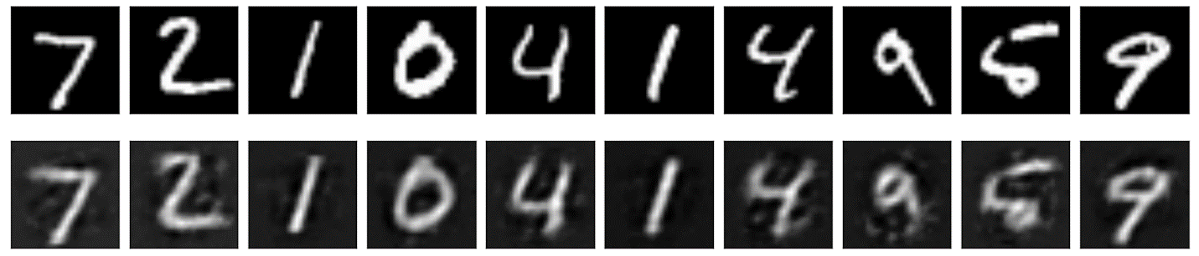
Улучшение эффективности автоэнкодера
    Important to note: the state-of-the-art level of our AE models.
    Our improvement of Kramer’s scheme is a result of the special study and consists in
    replacing sigmoidal activations by Leaky Rectified Linear (LReLU) activation with the carefully chosen parameter a different for each of data set;
    a specific input normalization (MinMax was chosen);
    (3) applying tied weights;
    (4) stochastic gradient descent (SGD) with Adam optimization.
    The idea of tied weights means the encode and decode weight matrices are simply transposes of each other, what gives less parameters to be optimized and stored and therefore faster training.
    We use Adaptive Moment Estimation (Adam) method for efficient SGD that only requires first-order gradients. Adam computes adaptive learning rates for each parameter and also keeps an exponentially decaying average of past gradients, similar to momentum of inertia.
    To determine the number of neurons in hidden layers of autoencoder we calculate the dependence of the AE loss function for different numbers of neurons in the bottle-neck and in both mapping-demapping layers taking into account the training time as well.
    Eventually, dimensions of 5 autoencoder layers were chosen as (m,256,64,256,m), where m is the length of the input vector.
After nonlinear compression input images
to 64 principal features in bottle-neck
layer AE recover them in output layer, as it
is shown for MNHIST data with LReLU activation original above, recovered below

Slide 20
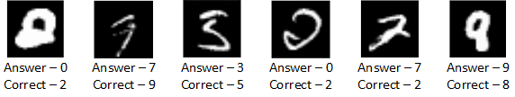
Оптимизация глубоких классификаторов
    We use SGD Adam minimization of the back-prop loss in our work with shallow, deep and deep belief neural networks. The numbers of hidden layers and optimal combination of hidden neurons per layer in our deep classifiers are chosen by the grid search cross-validation procedure taking into account NN efficiency dependencies on these numbers and the training time.
    All it gives two hidden layers for both DNN and DBN while the optimal numbers of the hidden neurons per 1st and 2^{d} layers are 300 and 100 respectively.
    The images of both data sets being rescaled to the 64-dimensional eigenvectors were classified then by three our classifiers with the following results:
Результаты тестирования
 | Perceptron | Deep Neural Network | Deep Belief Network
MNIST | 0.7977 | 0.9285 | 0.9839
FERET | 0.8750 | 1.0000 | 1.0000
Deep learning techniques give 100% classification efficiency on the faces database and 92 –98 % efficiency on the handwritten digits dataset. Although it is not a problem for the human to distinguish various faces, the DBN can make better predictions, even in the case of digits, than the human can.
Examples of incorrect DBN predictions are shown to emphasize the special difficulties of classifying handwritten digits even for the human.

Slide 21
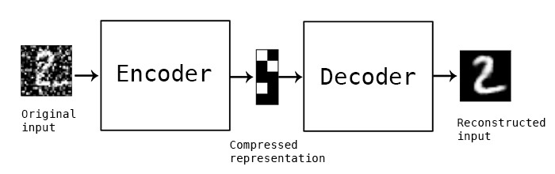
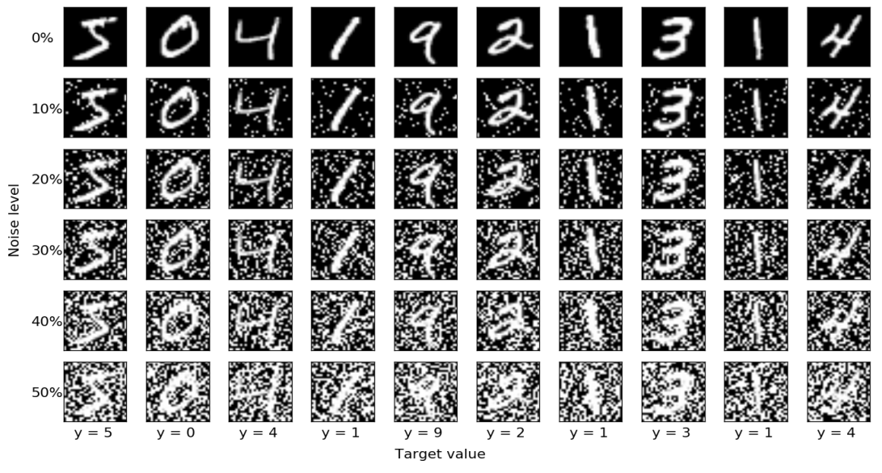
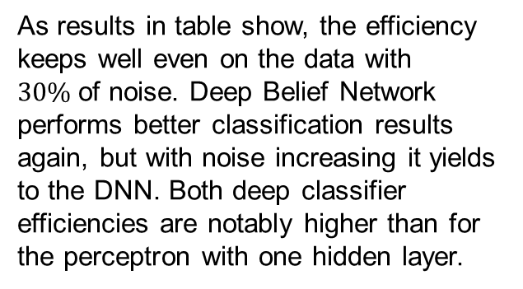
Применение автоэнкодеров для шумоподавления
A denoising procedure takes noisy data, as input, and outputs this data, where the noise is removed.
Our classifiers are trained on non-corrupted images. The denoising autoencoder network (DAEN) is trained with 20% noise added to input images. Then the classifiers are tested on six datasets with noise levels in range from 0% to 50% compressed previously by DAEN.
Examples of noisy images with different percentage of noise
 | FERET |  |  | MNIST
Noise (%) | Perceptron | DNN | DBN | Perceptron | DNN | DBN
0 | 0.9333 | 0.9867 | 1.0000 | 0.9587 | 0.9182 | 0.9861
10 | 0.9250 | 0.9867 | 0.9833 | 0.9135 | 0.8779 | 0.9644
20 | 0.8916 | 0.9750 | 0.9666 | 0.7921 | 0.7832 | 0.8794
30 | 0.8083 | 0.9583 | 0.9583 | 0.5272 | 0.6443 | 0.6027
40 | 0.3833 | 0.9667 | 0.9499 | 0.2496 | 0.5202 | 0.3863
50 | 0.025 | 0.9583 | 0.9333 | 0.1011 | 0.3973 | 0.2283
As results in table show, the efficiency keeps well even on the data with $30\%$of noise. Deep Belief Network performs better classification results again, but with noise increasing it yields to the DNN. Both deep classifier efficiencies are notably higher than for the perceptron with one hidden layer.
Efficiency results

Slide 22
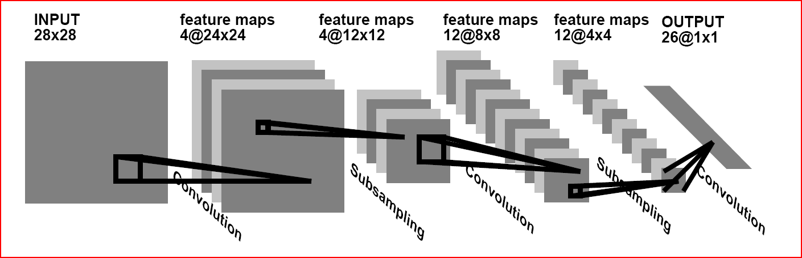
Сверточные нейросети для распознавания изображений
Recall to motivate: 1. DBN training time is too long
2. unsupervised learning algorithms for training RBMs by approximate maximum likelihood meet an intractable problem of measuring the likelihood that is to be optimized.
3. Direct applying regular neural nets to image recognition is useless because of two main factors: (i) input 2D image as a scanned 1D vector means the loss of the image space topology;
(ii) full connectivity of NN, where each neuron is fully connected to all neurons in the previous layer, is too wasteful due to the curse of dimensionality, besides the huge number of parameters would quickly lead to overfitting.
.
Instead, neurons of Convolutional Neural Networks (CNN) in a layer are only connected to a small region of the layer before it (Le Cun & Bengio, 1995,
see also http://cs231n.github.io/convolutional-networks/)

Slide 23
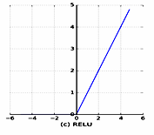
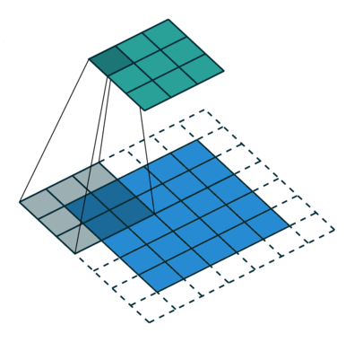
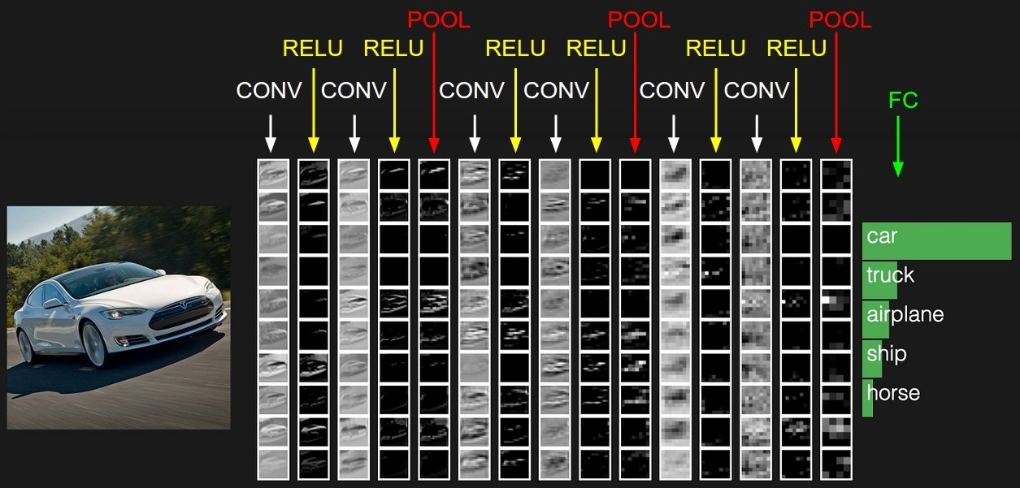
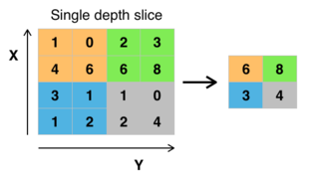
Основы архитектуры CNN
The CNN architecture is a sequence of layers, and every layer transforms one volume of activations to another through a filter which is a differentiable function.
There are three main types of layers to build CNN architectures: Convolutional Layer, Pooling (subsampling) Layer, and Fully-Connected Layer (just MLP with backprop). There are also RELU (rectified linear unit) layers performing the max(0,x)
Convolutional
layer
Activation: ReLU
Input or
feature map
Example of classifying by CNN
Each Layer accepts an input 3D volume (x,y,RGB color) and transforms it to an output 3D volume. To construct all filters of convolutional layers our CNN must be trained by a labeled sample with the back-prop method. See https://geektimes.ru/post/74326/ in Russian or tps://en.wikipedia.org/wiki/Convolutional_neural_network
Max pooling with a 2x2 filter

Slide 24
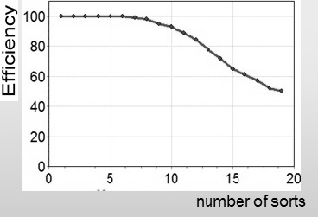
CNN в задаче классификации
белков твердой пшеницы
Recall,- the failure of any attempt to classify more than 10 sorts of wheat.
То solve the problem of classifying 50 wheat sorts presented as
3225 EF-densitogramms we propose to use two-step algorithm based on data-compression by an autoencoder on the first step followed then on the second step by applying either DNN or convolutional NN. To make a justified choice of AE we elaborate
also a convolutional one. So in our study we have to develop two versions of autoencoders and two versions of classifiers in order to compare them for better efficiency with reasonable time consuming.
Scheme of comparative study of DNN and CNN classifications

Slide 25
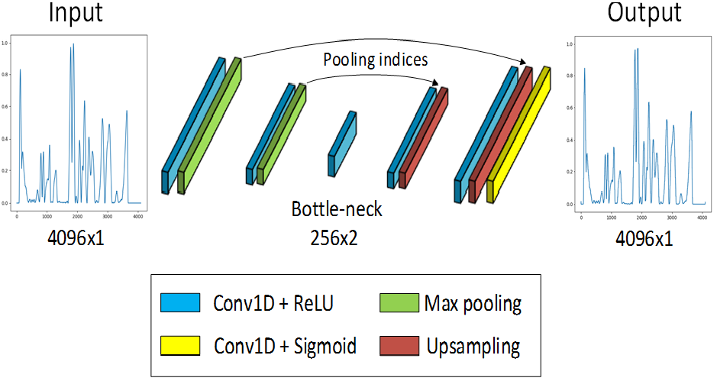
Сверточный автоэнкодер
We apply the improvements elaborated above for AE such as tied weights and
stochastic gradient descent (SGD) with Adam optimization.
The total number of CAE parameters is 315 what is 5 orders of magnitude less than for DNN AE and gives significant gain in memory to store AE as well as in training speed

Slide 26
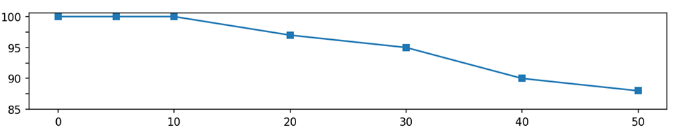
Сравнительные результаты классификации протеинов
Parameter | CNN | DNN
Model size (MB) | 3 | 66
Total epochs number | 150 | 400
Epoch time (s) | 1 | 0.2
Training time (s) | 69 | 84
Efficiency %
Number of sorts
Classification efficiency vs sort numbers (the same for CNN and DNN)
One can see advantages of convolutional network comparing to DNN. With the same efficiency CNN takes 22 times less memory, while its training time is faster.
Besides these results demonstrate the overwhelming superiority of the deep approach in the solution of protein classification problem.

Slide 27


Ускорение обучения ИНС путем применения карт GPU в облачной инфраструктуре
Classification model is developed on notebook Dell Vostro 5480 with hardware:
CPU: Intel Core i3-4500U @ 1.70 GHz (4 cores);
RAM: 4096 MB;
Graphic: Intel HD Graphics 4400.
One training epoch for convolutional autoencoder takes 70 – 80 sec,
but operating in the cloud service facilities provided by HybriLIT using TensorFlow and Keras we have:
Nvidia K80 + Keras + TensorFlow = it takes only 1 sec for 1 training epoch
TensorFlow is an open source software library for numerical computation using data flow graphs. Nodes in the graph represent mathematical operations, while the graph edges represent the multidimensional data arrays (tensors) communicated between them. TensorFlow can do calculations in parallel by installing required drivers and define special flags. To install GPU version, user must add «gpu» postfix after the name of package.
Keras is the Python Deep Learning library, which is a high-level API that uses TensorFlow as a backend

Slide 28
Немного философии об изменяющемся мире
В жизни мы имеем дело с объектами, изменяющимися во времени, и наш мозг, работая, всегда исходит из знания того, что уже было.
Однако обычные нейросети с одним скрытым слоем, глубокие сети, включая DBN, и даже такие продвинутые сети, как сверточные, предназначены для работы со статическими объектами. Никакое обучение не поможет традиционной нейросети смоделировать будущее состояние объекта.
Для описания динамического объекта нейронная сеть должна обладать некоей памятью, чтобы исходя не только из настоящего его состояния, но и из прошлого, нейросеть могла бы моделировать его последующее состояние.
Эту проблему решает семейство новых глубоких нейросетей, называмых рекуррентными (Recurrent Neural Networks-RNN). Они содержат в себе обратные связи, позволяющие сохранять информацию.

Slide 29
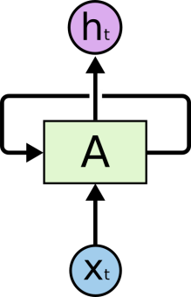
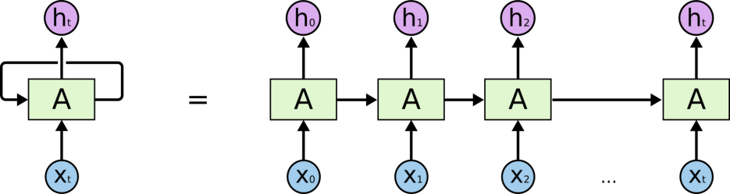
Рекуррентные нейронные сети
На схеме фрагмент нейронной сети A принимает входное значение xt и возвращает значение ht. Внутри этой ячейки – обычная сеть с одним скрытым слоем.
Наличие обратной связи позволяет передавать информацию от одного шага сети к другому. RNN можно рассматривать, как несколько копий одной и той же сети, каждая из которых передает информацию последующей копии
Так что RNN – самая естественная
архитектура нейронных сетей для работы с последовательностями и списками.
Однако, чтобы RNN могла связывать предыдущую информацию с текущей задачей, требуется ее усовершенствование до LSTM сети (Long short-term memory - долгая краткосрочная память) – особой разновидности архитектуры RNN, способной к обучению долговременным зависимостям.

Slide 30
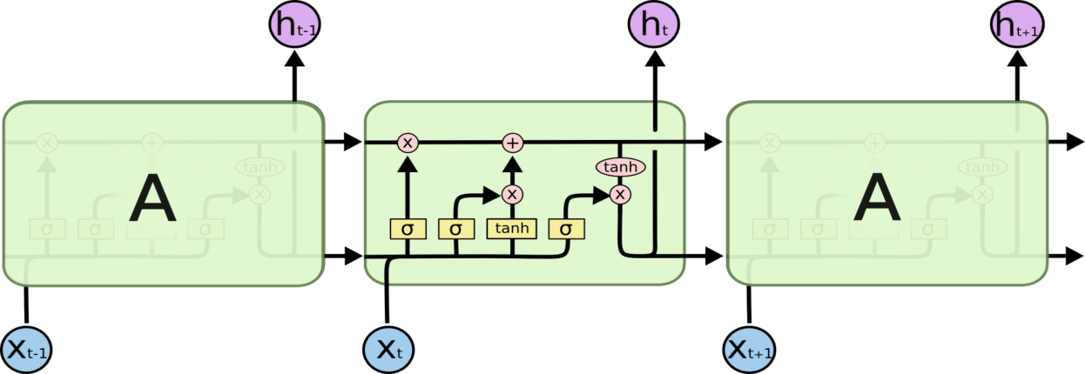




Сети LSTM
Вместо одного слоя RNN сети LSTM содержат целых четыре взаимодействующих слоя, позволяющих удалять информацию из состояния ячейки с помощью фильтров - gates. Фильтры состоят из слоя сигмоидальной нейронной сети и операции поточечного умножения и позволяют пропускать информацию на основании задаваемых условий.
Основной компонент LSTM – это своеобразная память сети –линия, проходящая по верхней части схемы.
С _{t-1}
С _{t}
В LSTM три фильтра, позволяющих защищать и контролировать состояние ячейки.
слой фильтра забывания определяет какую часть информации выбросить
2. что сохранить - 2 слоя: слой входного фильтра + tanh-слой
3. что получать на выходе

Slide 31
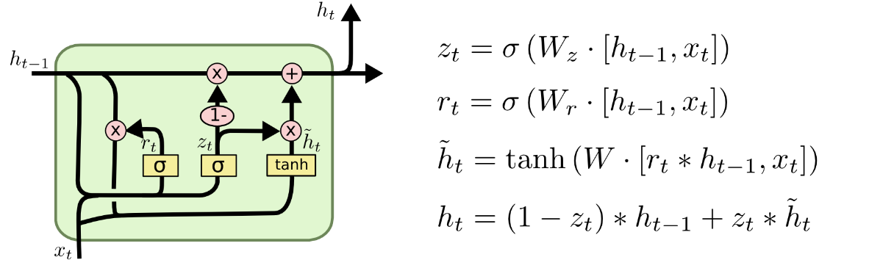
Управляемые рекуррентные модули
GRU (Gated Recurrent Unit)
Управляемый рекуррентный модуль GRU (Gated Recurrent Unit) является упрощенной версией LSTM. В нем фильтры «забывания» и входа объединяют в один фильтр «обновления» (update gate), а состояние ячейки объединяется со скрытым состоянием.
С помощью именно такой GRU нейросети нам удалось решить задачу начального восстановления траекторий элементарных частиц в детекторе GEM эксперимента BM@N в ОИЯИ. Доклад об этом будет в пятницу 29 сентября.

Slide 32
Как создавать, обучать и тестировать нейросети
расскажет магистр Гомельского Технического универcитета
Павел Гончаров.
Задача по распознаванию рукописных цифр из базы данных MNIST будет решена с помощью трех нейронных сетей:
Обычный однослойный персептрон;
Сверточная нейронная сеть;
Рекуррентная нейронная сеть.
С помощью уже упомянутых библиотек KERAS и TensorFlow на ваших глазах будут созданы эти три сети с объяснением выбора их структуры и параметров и посланы на обучение. Обученные сети будут протестированы для получения цифр сравнительной эффективности.
Все, что Павел расскажет, можно найти на сайте
https://github.com/Kaliostrogoblin/NEC2017-neural-networks-workshop

Slide 33

Thanks for your attention!
Notes:
33

